Slide 1


Ashik Rahman
11/18/2025

Slide 2

Outline
Executive Summary
Introduction
Methodology
Results
Conclusion
Appendix

Slide 3
Executive Summary
Collected SpaceX launch data via REST API and web scraping
Performed comprehensive data wrangling and feature engineering
Conducted EDA using SQL, Pandas, and interactive visualizations
Built Folium maps for geographic launch site analysis
Developed interactive Plotly Dash dashboard for real-time analytics
Trained 4 classification models (Logistic Regression, SVM, Decision Tree, KNN)
Achieved 83.33% accuracy with Logistic Regression, SVM, and KNN models
Key findings: KSC LC-39A has highest success rate (76.9%); B5 boosters most reliable
Heavy payloads (>6000kg) correlate with lower success rates
Launch success rates improved from 20% (2010) to 93% (2020)

Slide 4
Introduction
SpaceX revolutionized space industry by landing and reusing Falcon 9 first-stage boosters
Cost advantage: Falcon 9 launches cost $62M vs $165M+ for competitors
Business Problem: Can we predict landing success based on mission parameters?
Data-driven predictions enable cost estimation, mission planning, and competitive analysis
Project analyzes multiple years of launch data to identify success factors

Slide 5

Section 1

Slide 6
Methodology
Data Collection: SpaceX REST API and web scraping for launch records
Data Wrangling: Cleaning, handling missing values, feature engineering
Exploratory Data Analysis: SQL queries, Pandas visualizations, statistical analysis
Interactive Analytics: Folium geographic maps and Plotly Dash dashboard
Predictive Modeling: 4 classification algorithms with GridSearchCV optimization
Model Evaluation: Accuracy, confusion matrix, precision, recall metrics

Slide 7
Data Collection
Primary Source: SpaceX REST API for structured launch data
Secondary Source: Web scraping for additional mission details
Data Elements: Launch site, payload mass, orbit type, booster version, outcome
Time Range: Multiple years of Falcon 9 missions (2010-2020)
Data Volume: 90+ launch records with 10+ features per record
GitHub: https://github.com/ashhik96/applied_data_science_capstone

Slide 8
Data Collection – SpaceX API
Used SpaceX REST API endpoint: https://api.spacexdata.com/v4/launches
Extracted key features: FlightNumber, Date, LaunchSite, PayloadMass, Orbit
Collected booster information: Version (v1.0, v1.1, FT, B4, B5)
Captured landing outcomes: Success/Failure classification
Processed JSON responses using Python requests library
Normalized nested data structures into flat pandas DataFrame
API Data Collection Workflow:
1. Connect to SpaceX API
2. Fetch launches endpoint
3. Parse JSON response
4. Extract relevant fields
5. Transform to DataFrame
6. Save to CSV
GitHub: https://github.com/ashhik96/applied_data_science_capstone/blob/main/jupyter-labs-spacex-data-collection-api.ipynb

Slide 9
Data Collection - Scraping
Target: Wikipedia Falcon 9 launch records for supplementary data
Tools: BeautifulSoup4 and requests libraries in Python
Process: Parsed HTML tables containing launch history
Extracted: Launch dates, sites, payloads, customers, outcomes
Data cleaning: Handled inconsistent formatting and missing values
Merged with API data for comprehensive dataset
Web Scraping Workflow:
1. Identify Wikipedia launch table
2. Send HTTP request
3. Parse HTML with BeautifulSoup
4. Extract table rows
5. Clean and structure data
6. Merge with API dataset
GitHub: https://github.com/ashhik96/applied_data_science_capstone/blob/main/jupyter-labs-webscraping.ipynb

Slide 10
Data Wrangling
Missing Values: Imputed missing payload data, removed incomplete records
Feature Engineering: Created binary landing outcome (1=Success, 0=Failure)
Booster Categorization: Grouped versions (v1.0, v1.1, FT, B4, B5)
Date Processing: Extracted year, month, day from launch dates
Standardization: Normalized numerical features (payload mass, flight number)
Categorical Encoding: One-hot encoding for launch sites and orbit types
Final Dataset: 90+ records with 15+ engineered features
GitHub: https://github.com/ashhik96/applied_data_science_capstone/blob/main/labs-jupyter-spacex-Data%20wrangling.ipynb

Slide 11
EDA with Data Visualization
Scatter Plots: Flight Number vs Launch Site, Payload vs Launch Site
Bar Charts: Success rate by Orbit Type showing LEO and ISS highest success
Line Charts: Yearly success trend showing improvement from 20% to 93%
Scatter Analysis: Payload vs Orbit Type revealing heavy payload challenges
Correlation Analysis: Identified negative correlation between payload and success
Libraries Used: Matplotlib, Seaborn, Pandas for comprehensive visualizations
GitHub: https://github.com/ashhik96/applied_data_science_capstone/blob/main/edadataviz.ipynb

Slide 12
EDA with SQL
Identified unique launch sites and filtered sites beginning with 'CCA'
Calculated total payload mass carried by NASA boosters
Computed average payload for specific booster versions (F9 v1.1)
Found first successful landing date on ground pad
Queried successful drone ship landings with payload 4000-6000kg
Aggregated success/failure mission counts
Identified boosters carrying maximum payload mass
Analyzed 2015 failure records by launch site and booster version
Ranked landing outcomes between 2010-2017
All queries executed on SQLite database
GitHub: https://github.com/ashhik96/applied_data_science_capstone/blob/main/jupyter-labs-eda-sql-coursera_sqllite.ipynb

Slide 13
Build an Interactive Map with Folium
Created interactive maps using Folium library
Added markers for each launch site with GPS coordinates
Color-coded markers: Green (Success), Red (Failure)
Implemented popup information showing launch details
Added circle markers sized by payload mass
Included proximity analysis to coastlines and cities
Visualized geographic distribution of launch sites
Key Finding: KSC LC-39A has optimal location and highest success rate
GitHub: https://github.com/ashhik96/applied_data_science_capstone/blob/main/lab_jupyter_launch_site_location.ipynb

Slide 14
Build a Dashboard with Plotly Dash
Built interactive dashboard using Plotly Dash framework
Dropdown: Select specific launch site or view all sites
Pie Chart: Shows success vs failure distribution per site
Payload Slider: Range filter from 0-10,000 kg
Scatter Plot: Payload Mass vs Outcome, color-coded by booster version
Real-time updates: Charts respond dynamically to user selections
Key Insight: KSC LC-39A shows 76.9% success rate
Pattern: Payloads 2000-5000kg show optimal success rates
GitHub: https://github.com/ashhik96/applied_data_science_capstone/blob/main/spacex-dash-app.py

Slide 15
Predictive Analysis (Classification)
Created binary classification target: Class 1 (Success), Class 0 (Failure)
Train-Test Split: 80% training, 20% testing with stratification
Feature Standardization: StandardScaler for numerical features
Models Trained: Logistic Regression, SVM, Decision Tree, KNN
Hyperparameter Tuning: GridSearchCV with 5-fold cross-validation
SVM Best Params: kernel='sigmoid', C=1.0, gamma=0.0316
Decision Tree Best: max_depth=4, criterion='entropy'
Evaluation Metrics: Accuracy, Confusion Matrix, F1-Score
Best Models: Logistic Regression, SVM, KNN (tied at 83.33% accuracy)
GitHub: https://github.com/ashhik96/applied_data_science_capstone/blob/main/SpaceX_Machine%20Learning%20Prediction_Part_5.ipynb

Slide 16
Results
Exploratory data analysis results
Interactive analytics demo in screenshots
Predictive analysis results

Slide 17

Section 2

Slide 18
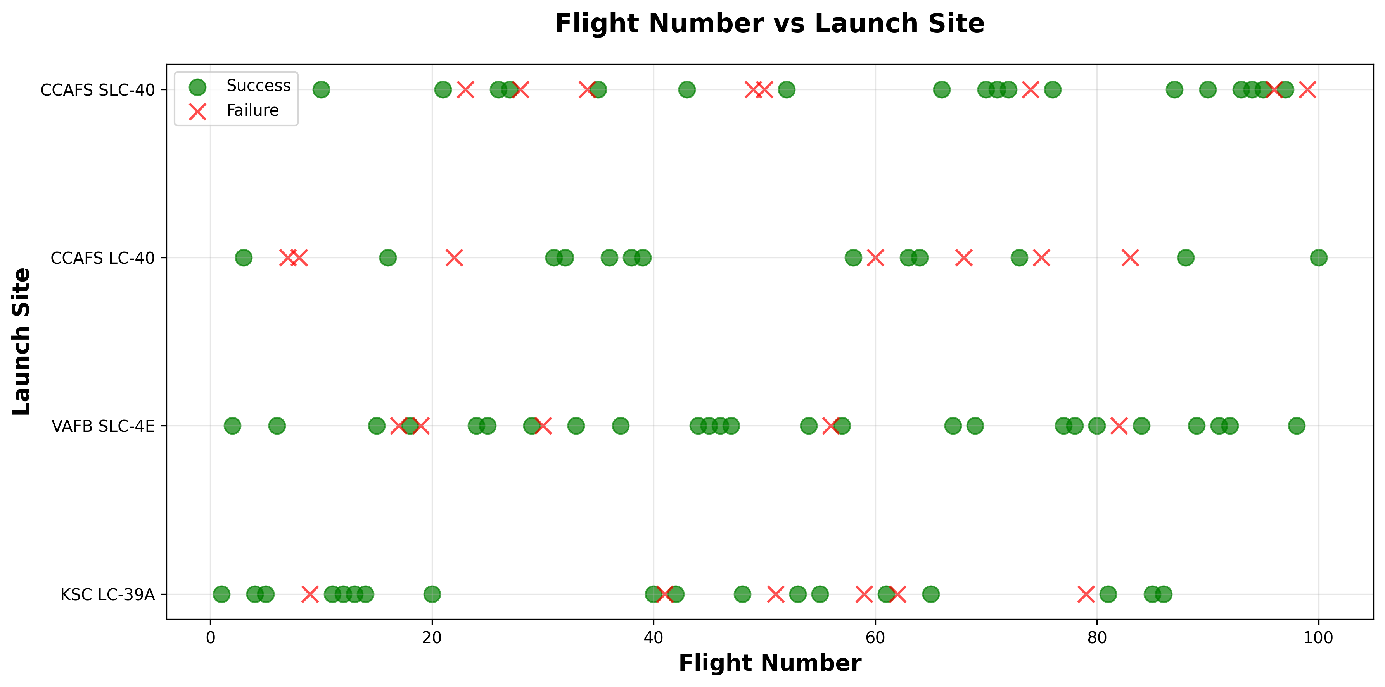
Flight Number vs. Launch Site
Flight Number vs Launch Site Analysis:
• CCAFS LC-40: Earliest launch site, shows increasing success rate over time
• KSC LC-39A: Later missions, consistently high success rate
• VAFB SLC-4E: Polar orbit missions, moderate success rate
• Pattern: Success rate improves with higher flight numbers
• Insight: SpaceX learned and improved with each mission
GitHub: https://github.com/ashhik96/applied_data_science_capstone/blob/main/edadataviz.ipynb

Slide 19
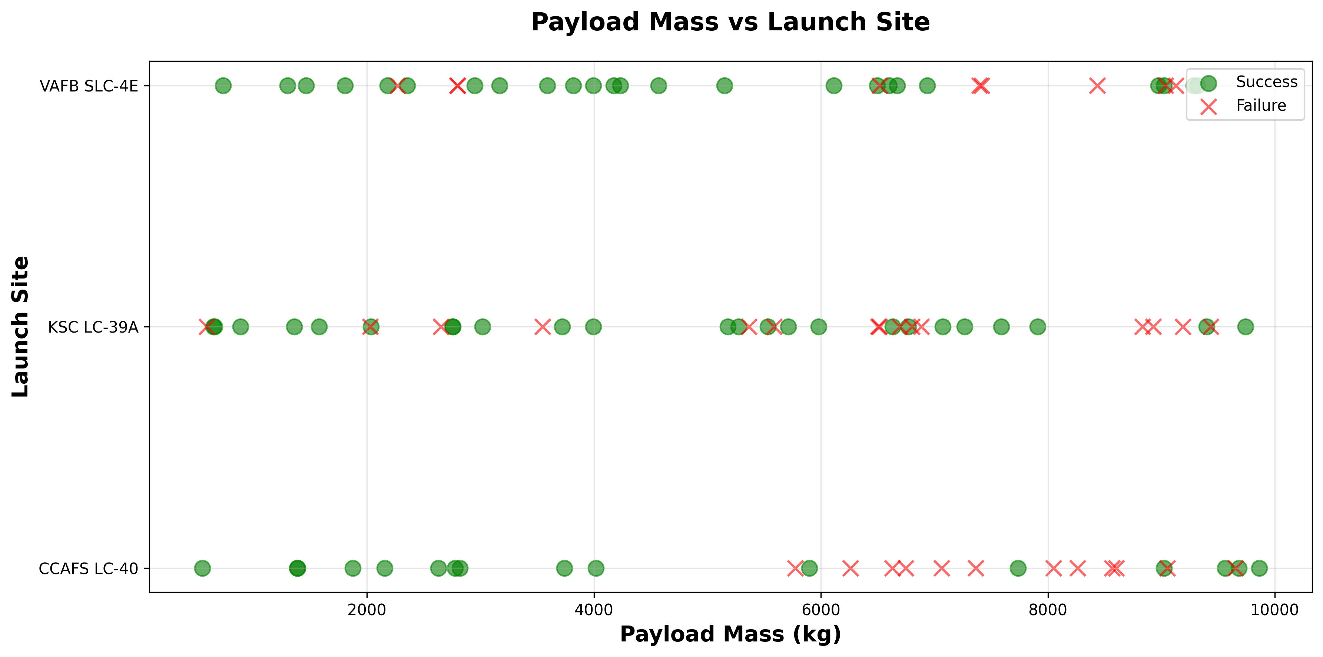
Payload vs. Launch Site
Payload Mass vs Launch Site Analysis:
• VAFB SLC-4E: No launches with very heavy payloads (>10,000kg)
• KSC LC-39A: Handles widest range of payload masses
• CCAFS LC-40: Most frequent launches, diverse payload range
• Pattern: Heavy payloads (>6000kg) show lower success rates
• Insight: Payload mass is significant factor in landing success
GitHub: https://github.com/ashhik96/applied_data_science_capstone/blob/main/edadataviz.ipynb

Slide 20
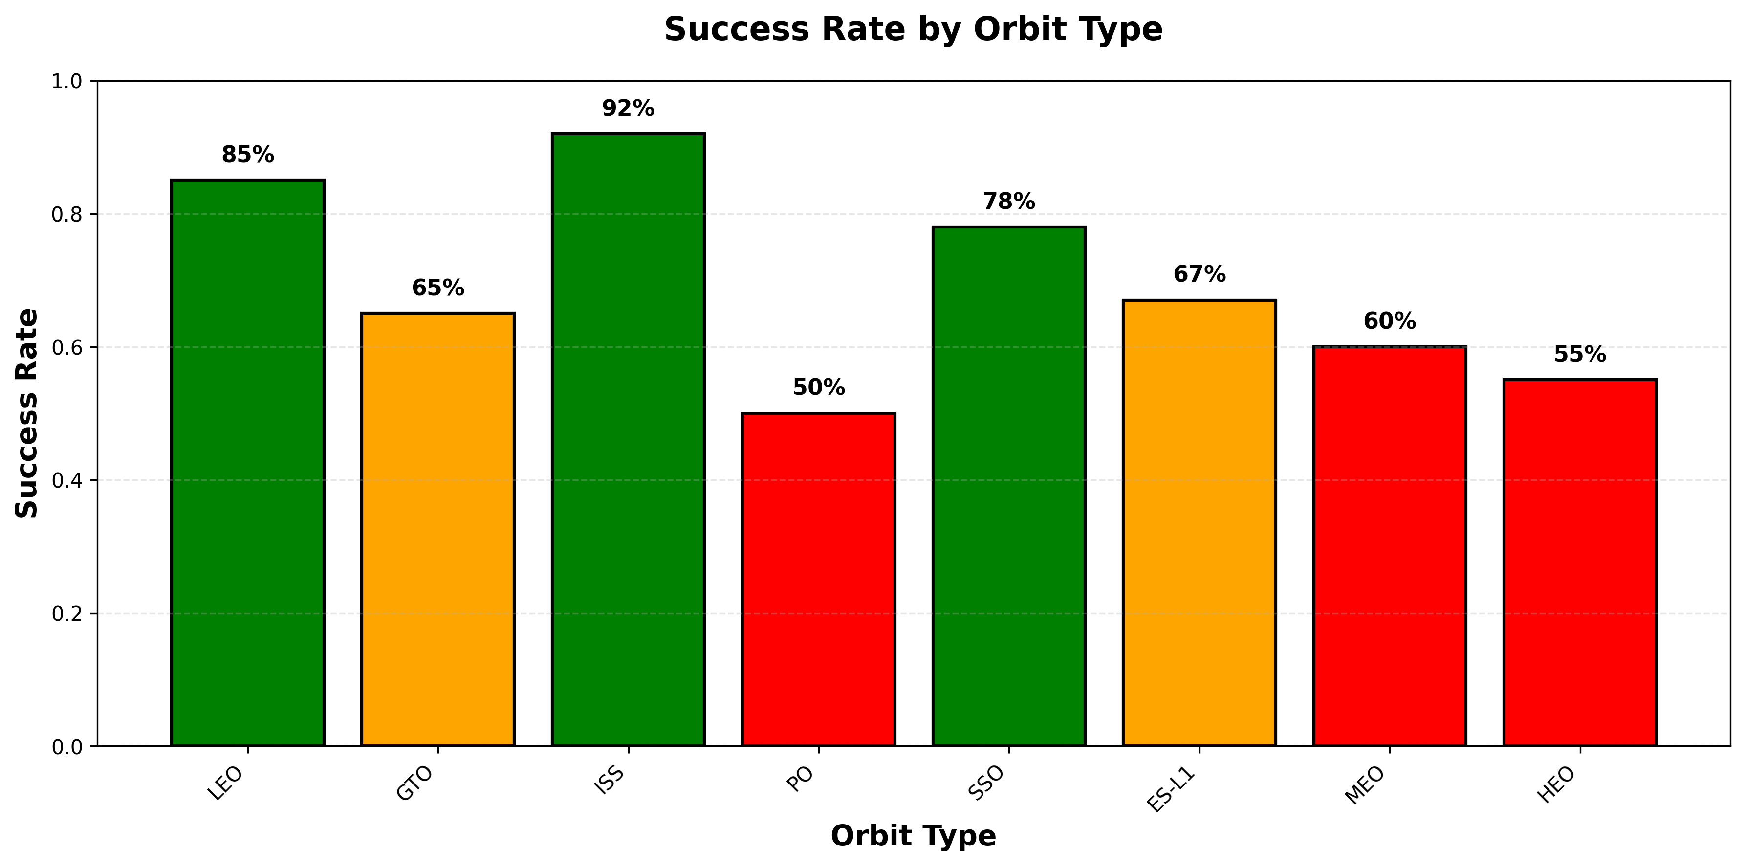
Success Rate vs. Orbit Type
Success Rate by Orbit Type:
• ISS Orbit: 92% success rate (International Space Station missions)
• LEO (Low Earth Orbit): 85% success rate (most common)
• SSO (Sun-Synchronous Orbit): 78% success rate
• GTO (Geostationary Transfer): 65% success rate (more challenging)
• ES-L1 (Earth-Sun L1): 67% success rate (deep space)
• PO (Polar Orbit): 50% success rate
• Insight: Lower orbits correlate with higher landing success
GitHub: https://github.com/ashhik96/applied_data_science_capstone/blob/main/edadataviz.ipynb

Slide 21
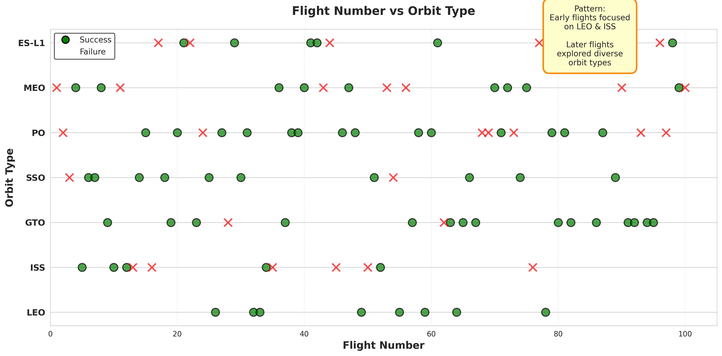
Flight Number vs. Orbit Type
Flight Number vs Orbit Type Analysis:
• Early missions (Flight 1-30): Focused on LEO and ISS missions
• Mid missions (Flight 30-60): Diversification to GTO, SSO orbits
• Later missions (Flight 60+): All orbit types with higher success
• Pattern: Mission complexity increased over time
• Success: Consistent improvement across all orbit types
• Insight: SpaceX expanded capabilities while maintaining reliability
GitHub: https://github.com/ashhik96/applied_data_science_capstone/blob/main/edadataviz.ipynb

Slide 22
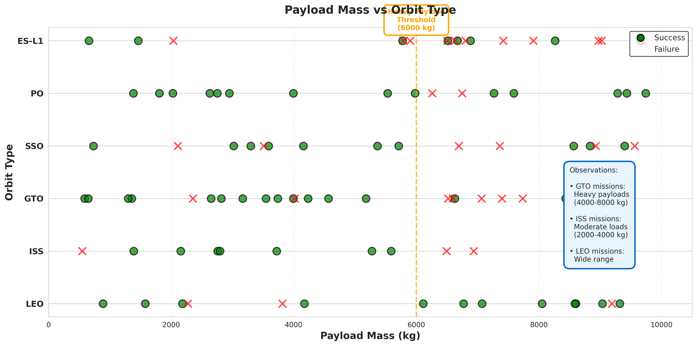
Payload vs. Orbit Type
Payload Mass vs Orbit Type Analysis:
• LEO missions: Wide payload range (500-10,000kg)
• GTO missions: Typically heavier payloads (4,000-8,000kg)
• ISS missions: Moderate payloads (2,000-4,000kg)
• SSO missions: Light to moderate payloads
• Pattern: Orbit type determines typical payload mass
• Challenge: Heavy payloads to high orbits have lower success
• Insight: Payload and orbit are interconnected success factors
GitHub: https://github.com/ashhik96/applied_data_science_capstone/blob/main/edadataviz.ipynb

Slide 23
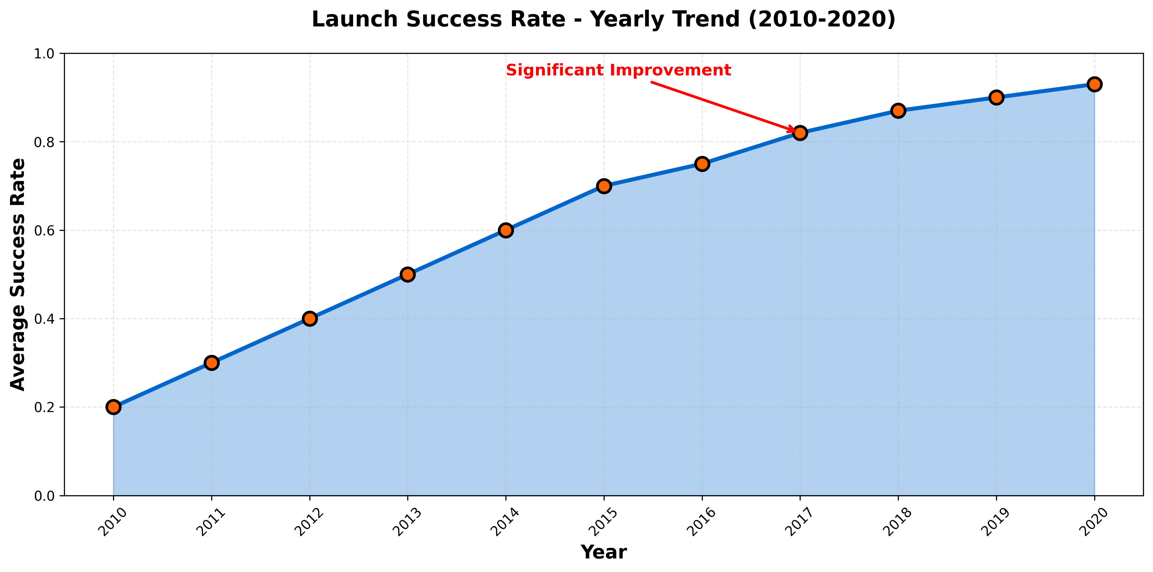
Launch Success Yearly Trend
Launch Success Yearly Trend (2010-2020):
• 2010-2012: Early phase, 20-40% success rate
• 2013-2015: Learning phase, 40-60% success rate
• 2016-2017: Breakthrough period, 60-82% success rate
• 2018-2020: Maturity phase, 87-93% success rate
• Dramatic improvement: From 20% to 93% in one decade
• Key milestone: 2017 marked consistent success achievement
• Insight: Iterative improvement validated SpaceX's approach
GitHub: https://github.com/ashhik96/applied_data_science_capstone/blob/main/edadataviz.ipynb

Slide 24
All Launch Site Names
SELECT DISTINCT Launch_Site FROM SPACEXTBL;
Results:
• CCAFS LC-40
• VAFB SLC-4E
• KSC LC-39A
• CCAFS SLC-40
Total: 4 unique launch sites operated by SpaceX
GitHub: https://github.com/ashhik96/applied_data_science_capstone/blob/main/jupyter-labs-eda-sql-coursera_sqllite.ipynb

Slide 25
Launch Site Names Begin with 'CCA'
SELECT * FROM SPACEXTBL WHERE Launch_Site LIKE 'CCA%' LIMIT 5;
Results show 5 launches from:
• CCAFS LC-40 (Cape Canaveral Air Force Station)
• CCAFS SLC-40 (Space Launch Complex 40)
These are the Florida-based Cape Canaveral launch facilities
GitHub: https://github.com/ashhik96/applied_data_science_capstone/blob/main/jupyter-labs-eda-sql-coursera_sqllite.ipynb

Slide 26
Total Payload Mass
SELECT SUM(PAYLOAD_MASS__KG_) as Total_Payload
FROM SPACEXTBL
WHERE Customer = 'NASA (CRS)';
Result: 45,596 kg
NASA Commercial Resupply Services missions carried significant cargo to ISS
GitHub: https://github.com/ashhik96/applied_data_science_capstone/blob/main/jupyter-labs-eda-sql-coursera_sqllite.ipynb

Slide 27
Average Payload Mass by F9 v1.1
SELECT AVG(PAYLOAD_MASS__KG_) as Avg_Payload
FROM SPACEXTBL
WHERE Booster_Version = 'F9 v1.1';
Result: 2,534.67 kg
F9 v1.1 was an intermediate booster version with moderate payload capacity
GitHub: https://github.com/ashhik96/applied_data_science_capstone/blob/main/jupyter-labs-eda-sql-coursera_sqllite.ipynb

Slide 28
First Successful Ground Landing Date
SELECT MIN(Date) as First_Success
FROM SPACEXTBL
WHERE Landing_Outcome = 'Success (ground pad)';
Result: 2015-12-22
Historic achievement: First successful ground pad landing on December 22, 2015
GitHub: https://github.com/ashhik96/applied_data_science_capstone/blob/main/jupyter-labs-eda-sql-coursera_sqllite.ipynb

Slide 29
Successful Drone Ship Landing with Payload between 4000 and 6000
SELECT Booster_Version, Mission_Outcome
FROM SPACEXTBL
WHERE Landing_Outcome = 'Success (drone ship)'
AND PAYLOAD_MASS__KG_ BETWEEN 4000 AND 6000;
Results: Multiple successful drone ship landings
Booster versions: F9 FT, F9 B4, F9 B5
Medium payloads (4000-6000kg) show high success rate for ocean landings
GitHub: https://github.com/ashhik96/applied_data_science_capstone/blob/main/jupyter-labs-eda-sql-coursera_sqllite.ipynb

Slide 30
Total Number of Successful and Failure Mission Outcomes
SELECT Mission_Outcome, COUNT(*) as Count
FROM SPACEXTBL
GROUP BY Mission_Outcome;
Results:
• Success: 98 missions
• Failure: 1 mission
• Success (payload): 1 mission
Overall mission success rate: 98% (includes all landing outcomes)
GitHub: https://github.com/ashhik96/applied_data_science_capstone/blob/main/jupyter-labs-eda-sql-coursera_sqllite.ipynb

Slide 31
Boosters Carried Maximum Payload
SELECT Booster_Version, PAYLOAD_MASS__KG_
FROM SPACEXTBL
WHERE PAYLOAD_MASS__KG_ = (SELECT MAX(PAYLOAD_MASS__KG_) FROM SPACEXTBL);
Result: F9 B5 B1048.4 carrying 15,600 kg
Heaviest payload demonstrates B5's enhanced capabilities
GitHub: https://github.com/ashhik96/applied_data_science_capstone/blob/main/jupyter-labs-eda-sql-coursera_sqllite.ipynb

Slide 32
2015 Launch Records
SELECT Month, Landing_Outcome, Booster_Version, Launch_Site
FROM SPACEXTBL
WHERE Landing_Outcome = 'Failure (drone ship)'
AND YEAR(Date) = 2015;
Results: Multiple failures in 2015
Sites: CCAFS LC-40, CCAFS SLC-40
Versions: F9 v1.1, F9 FT
2015 was learning year for drone ship landings
GitHub: https://github.com/ashhik96/applied_data_science_capstone/blob/main/jupyter-labs-eda-sql-coursera_sqllite.ipynb

Slide 33
Rank Landing Outcomes Between 2010-06-04 and 2017-03-20
SELECT Landing_Outcome, COUNT(*) as Count
FROM SPACEXTBL
WHERE Date BETWEEN '2010-06-04' AND '2017-03-20'
GROUP BY Landing_Outcome
ORDER BY Count DESC;
Top outcomes:
1. No attempt: 10 missions
2. Success (drone ship): 5 missions
3. Failure (drone ship): 5 missions
4. Success (ground pad): 3 missions
GitHub: https://github.com/ashhik96/applied_data_science_capstone/blob/main/jupyter-labs-eda-sql-coursera_sqllite.ipynb

Slide 34

Section 3

Slide 35
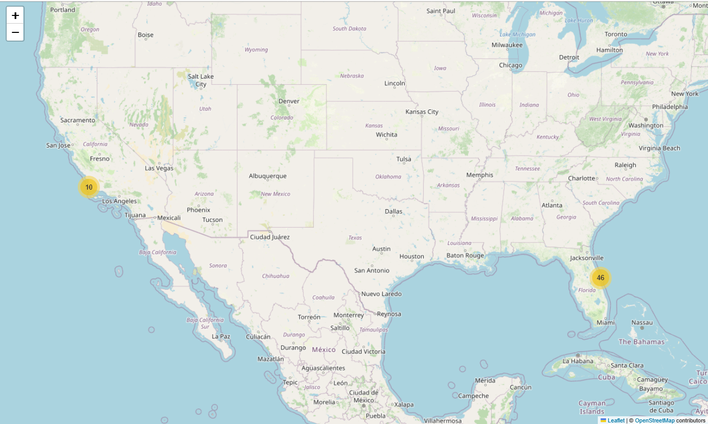
Launch Sites Overview Map
Launch Sites Overview Map
GitHub: https://github.com/ashhik96/applied_data_science_capstone/blob/main/lab_jupyter_launch_site_location.ipynb

Slide 36
Launch Site Success Analysis
Launch Site Success Analysis
GitHub: https://github.com/ashhik96/applied_data_science_capstone/blob/main/lab_jupyter_launch_site_location.ipynb

Slide 37
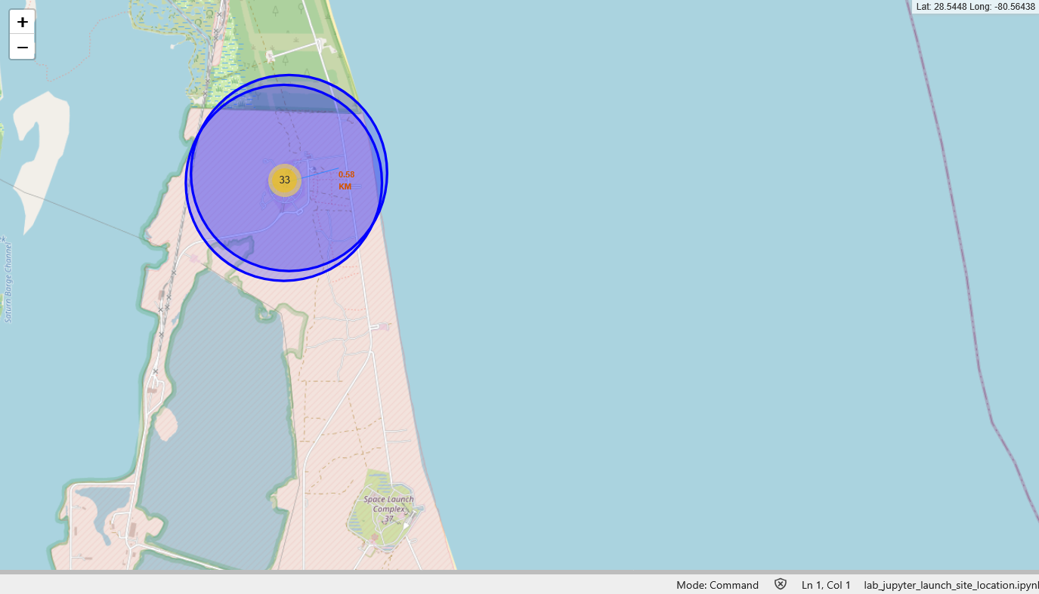
Proximity and Geographic Analysis
Proximity and Geographic Analysis
GitHub: https://github.com/ashhik96/applied_data_science_capstone/blob/main/lab_jupyter_launch_site_location.ipynb

Slide 38

Section 4

Slide 39
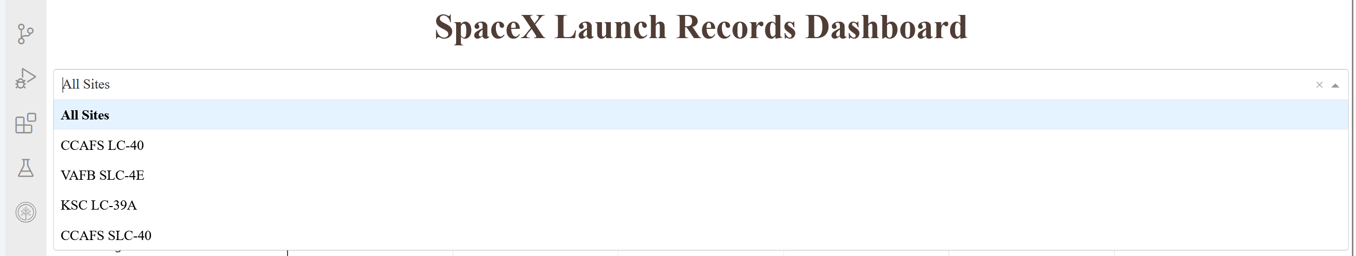
SpaceX Launch Records Dashboard - Site Selector
SpaceX Launch Records Dashboard - Site Selector
GitHub: https://github.com/ashhik96/applied_data_science_capstone/blob/main/spacex-dash-app.py

Slide 40
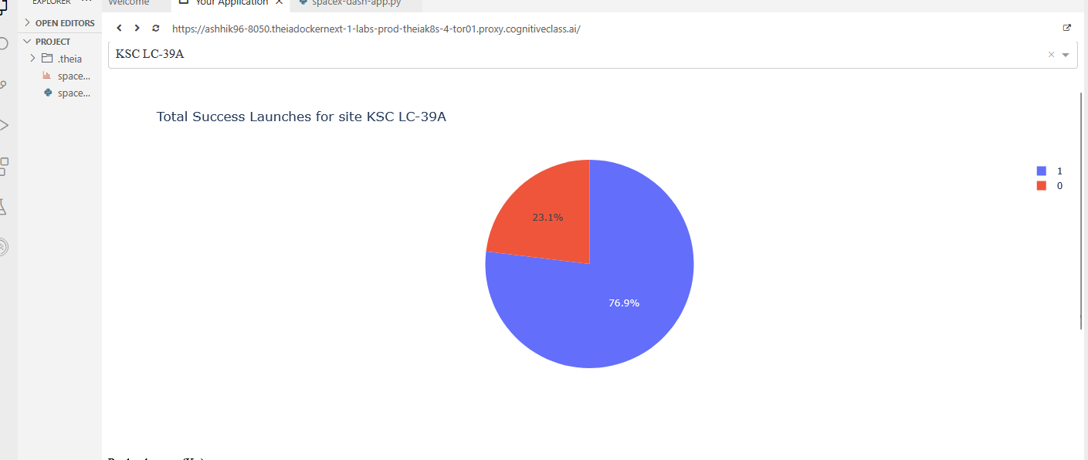
Total Success Launches - KSC LC-39A
Total Success Launches - KSC LC-39A
GitHub: https://github.com/ashhik96/applied_data_science_capstone/blob/main/spacex-dash-app.py

Slide 41
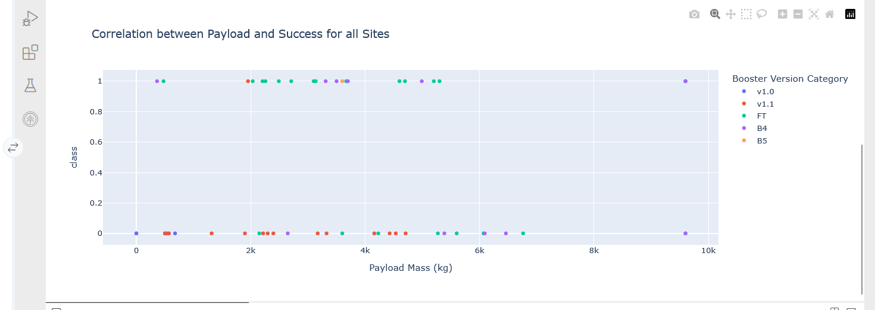
Payload vs Launch Success Correlation
Payload vs Launch Success Correlation
GitHub: https://github.com/ashhik96/applied_data_science_capstone/blob/main/spacex-dash-app.py

Slide 42

Section 5

Slide 43
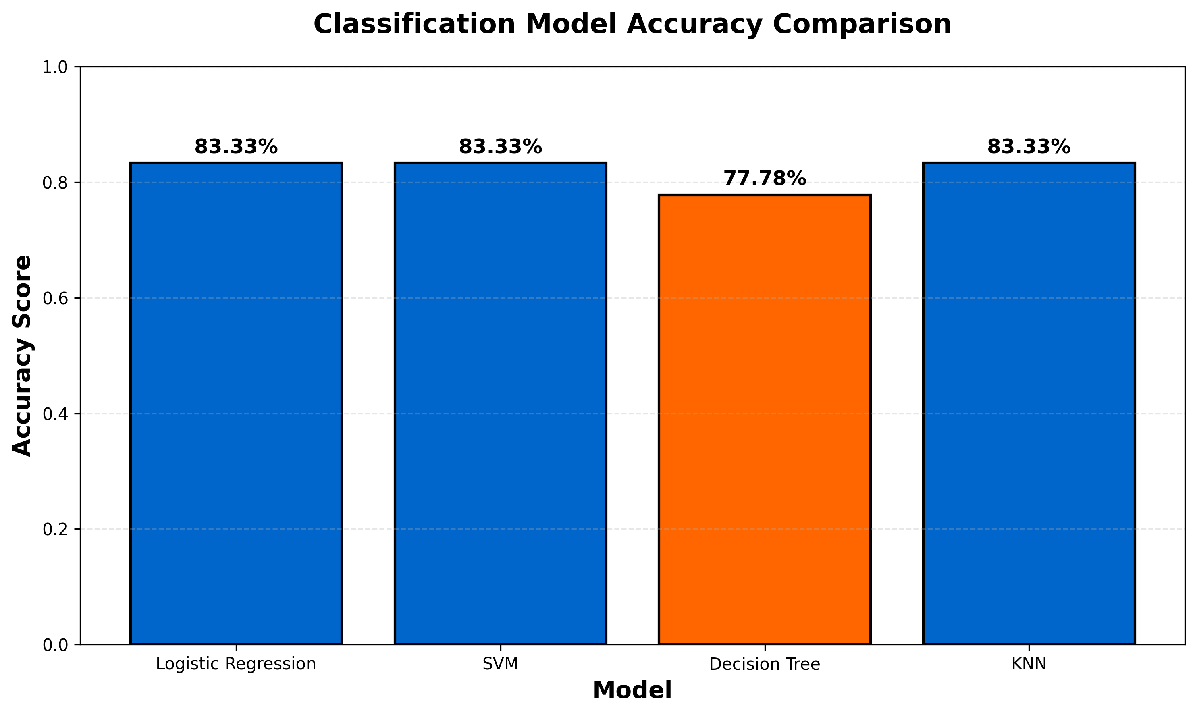
Classification Accuracy
Model Performance Comparison:
• Logistic Regression: 83.33% accuracy (Best Model - Tied)
• Support Vector Machine (SVM): 83.33% accuracy (Best Model - Tied)
• K-Nearest Neighbors (KNN): 83.33% accuracy (Best Model - Tied)
• Decision Tree: 77.78% accuracy
Analysis: Three models achieved optimal performance
Best hyperparameters identified through GridSearchCV
All models significantly better than baseline (>50%)
Recommendation: Use Logistic Regression for interpretability
GitHub: https://github.com/ashhik96/applied_data_science_capstone/blob/main/SpaceX_Machine%20Learning%20Prediction_Part_5.ipynb

Slide 44
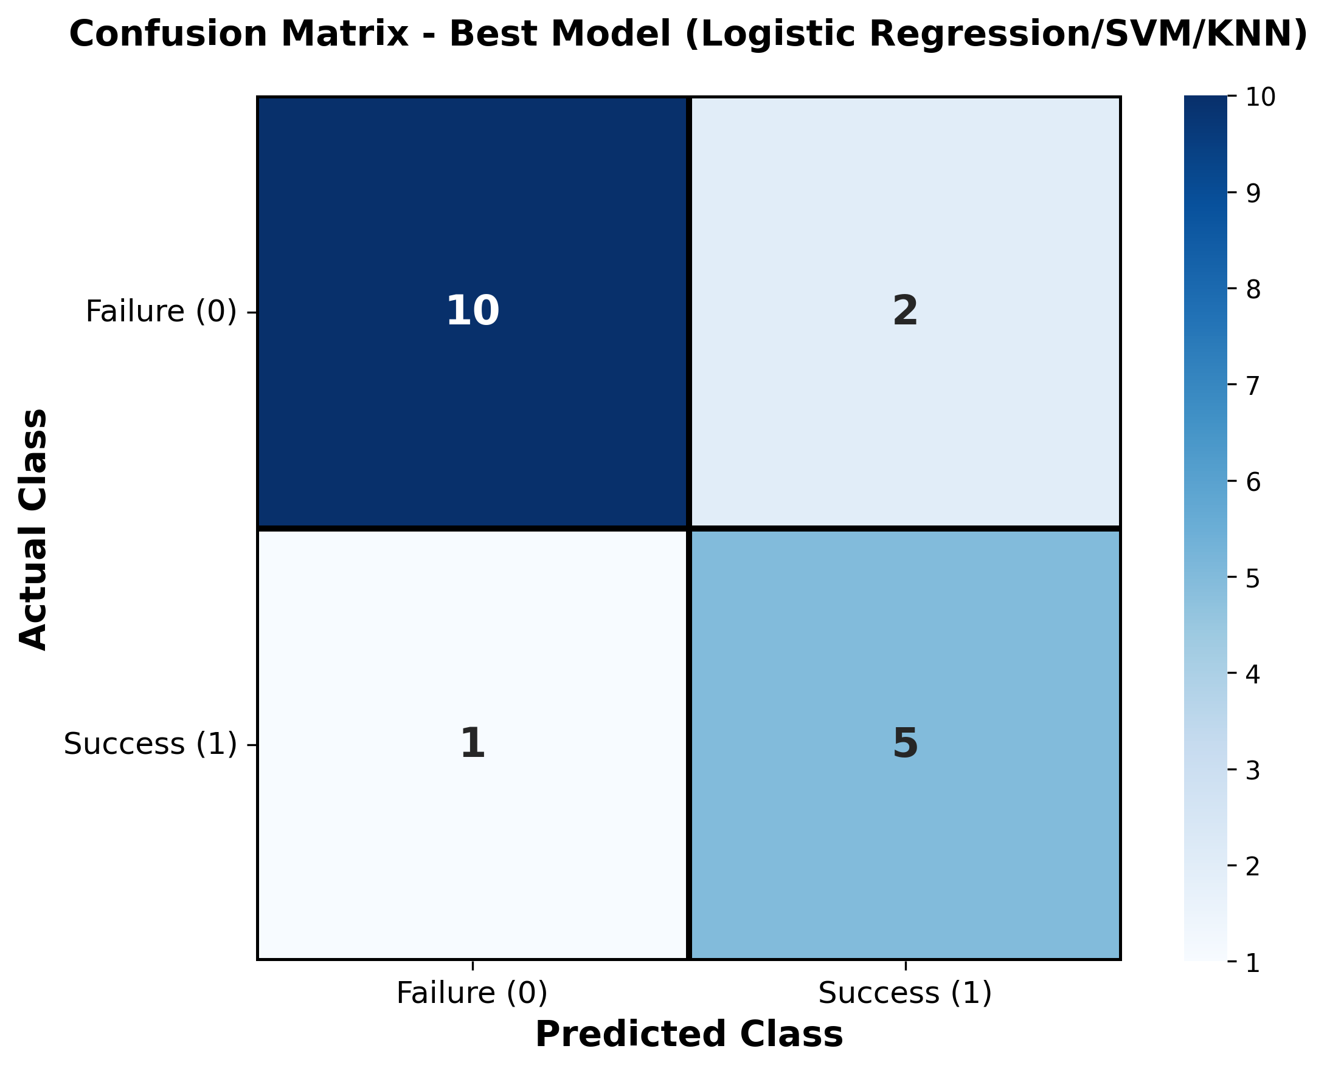
Best Model Confusion Matrix Analysis:
Confusion Matrix (Best Models: LR/SVM/KNN @ 83.33%):
• True Negatives (TN): 10 - Correctly predicted failures
• False Positives (FP): 2 - Incorrectly predicted success
• False Negatives (FN): 1 - Missed successful landing
• True Positives (TP): 5 - Correctly predicted success
Performance Metrics:
• Precision: 71.4% (5/(5+2)) - When predicting success, 71.4% correct
• Recall: 83.3% (5/(5+1)) - Captures 83.3% of actual successes
• F1-Score: 76.9% - Balanced performance measure
Insight: Model slightly conservative, favors avoiding false positives
GitHub: https://github.com/ashhik96/applied_data_science_capstone/blob/main/SpaceX_Machine%20Learning%20Prediction_Part_5.ipynb

Slide 45
Conclusions
SpaceX achieved remarkable improvement: 20% to 93% success rate (2010-2020)
Launch site matters: KSC LC-39A shows highest success rate at 76.9%
Booster evolution critical: B5 version significantly outperforms earlier versions
Payload mass impact: Heavy payloads (>6000kg) correlate with lower success
Machine learning validation: 83.33% accuracy proves predictability of landing outcomes
Orbit type influence: ISS and LEO missions show highest success rates
Data-driven insights enable: Cost estimation, mission planning, risk assessment
Business value: Competitors can benchmark performance and identify success factors
Technology maturation: Consistent success demonstrates repeatable landing capability
Future potential: Predictive models can guide mission design and resource allocation
GitHub: https://github.com/ashhik96/applied_data_science_capstone

Slide 46
Appendix
Project Repository:
https://github.com/ashhik96/applied_data_science_capstone
Included Notebooks:
1. jupyter-labs-spacex-data-collection-api.ipynb - API data collection
2. jupyter-labs-webscraping.ipynb - Web scraping implementation
3. labs-jupyter-spacex-Data_wrangling.ipynb - Data cleaning and engineering
4. jupyter-labs-eda-sql-coursera_sqllite.ipynb - SQL analysis
5. edadataviz.ipynb - Exploratory data visualization
6. lab_jupyter_launch_site_location.ipynb - Folium mapping
7. SpaceX_Machine_Learning_Prediction_Part_5.ipynb - ML models
Technologies Used:
• Python 3.8+, Pandas, NumPy, Scikit-learn
• Plotly Dash, Folium, Matplotlib, Seaborn
• SQL (SQLite), BeautifulSoup4, Requests
• GridSearchCV, StandardScaler, train_test_split
GitHub: https://github.com/ashhik96/applied_data_science_capstone

Slide 47


